Slide 1
Portfolio Analysis & Selection using CAPM & VAR- Upgrad Project
Josemon Joy

Slide 2
Business Problem
"How can we design a personalized and data-driven stock portfolio for an individual investor (Ms. Alexandra Kolishnyick), that aligns with her financial goals, risk appetite, and investment horizon — using historical stock data, financial metrics, and predictive models?"

Slide 3
Objectives
Selection of Portfolio using CAPM
Prediction & Optimization of Portfolio

Slide 4
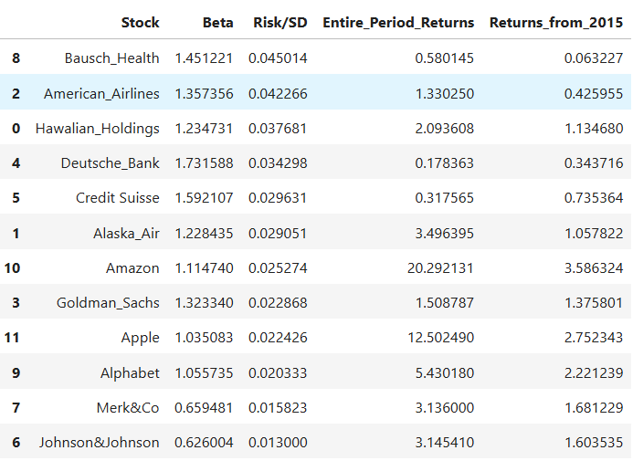
Stock Selection Metrics

Slide 5
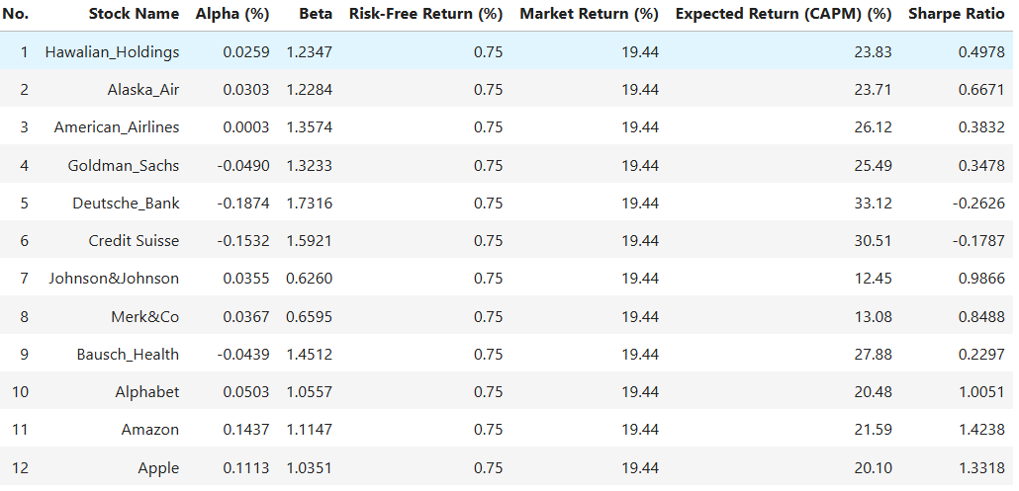
Stocks Selection Metrics

Slide 6
Observations
Amazon - High Growth stock with strong performance beyond market expectations
Apple - Stable tech stock offering excellent long-term value- Alphabet - Consistent performer with balanced risk & reward
American Airlines - High return potential but with elevated market risk
Goldman Sachs - Expected to perform well, but slightly underperforms market adjusted return
Deutsche Bank - Very risky and underperforming - avoid for conservative investors-
Credit Suisse - Negative alpha suggests inefficiency despite high beta returns-
Bausch Health - Unstable return performance - caution advised
Johnson&Johnson - low risk, reliable returns
Merk & Co - Steady and low-risk investment

Slide 7
Stock Selection Decision Making
Buy/Hold: Amazon, Apple, Alphabet –
Cautious Considerations: American Airlines, Goldman Sachs –
Avoid or Reduce Exposure: Deutsche Bank, Credit Suisse, Bausch Health –
Add for stability: Johnson & Johnson, Merk&Co

Slide 8
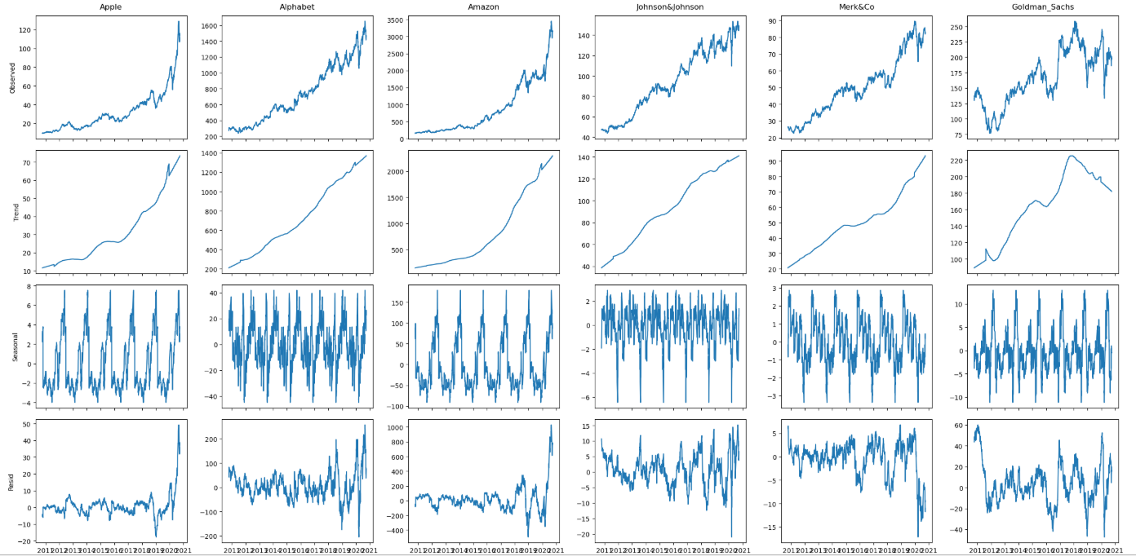
Time Series Decomposition of Selected Stocks

Slide 9
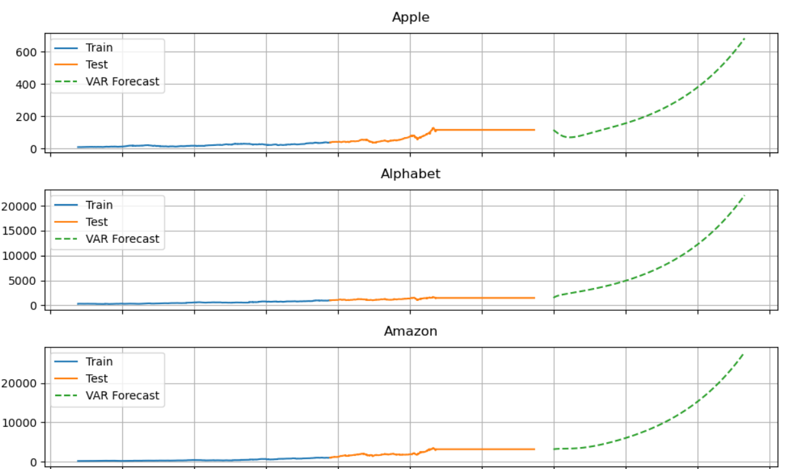
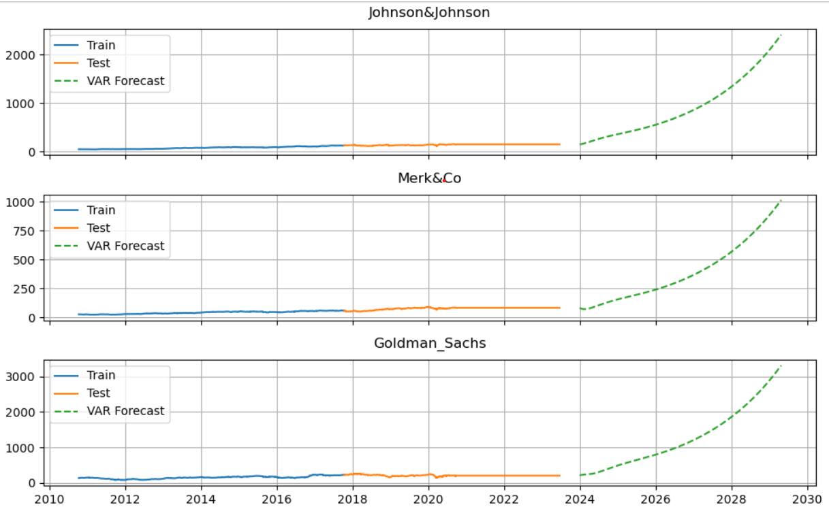
Stock-VAR price predictions

Slide 10
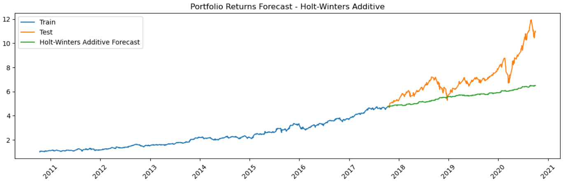
Portfolio Forecast

Slide 11
Why we included Alphabet & Goldman Sachs in the Portfolio?
Goldman Sachs have a better beta of 1.32 with comparatively low risk and a positive entire period return about 150%.
Alphabet have a better beta(market sensitivity) of 1.05, comparatively low risk of 0.02, and a robust entire period return of 543% return.
Why excluded Alphabet & Goldman Sachs from the Portfolio?
Goldman Sachs have a negative alpha value of -0.049 indicates stock is not a resilient one to add on portfolio
Alphabet avoided because of balancing the portfolio return, since Apple and Amazon have a higher market sensitiveness.

Slide 12
Allocation of Optimized Portfolio
Portfolio Allocation: 'Apple': 0.33752, 'Amazon': 0.37828, 'Johnson&Johnson': 0.1553, 'Merk&Co': 0.1289, 'Goldman_Sachs': 0.0, 'Alphabet': 0.0
Expected annual return: 47.9%
Annual volatility: 25.4%
Sharpe Ratio: 1.89

Slide 13
THANK YOU

